Slide 1
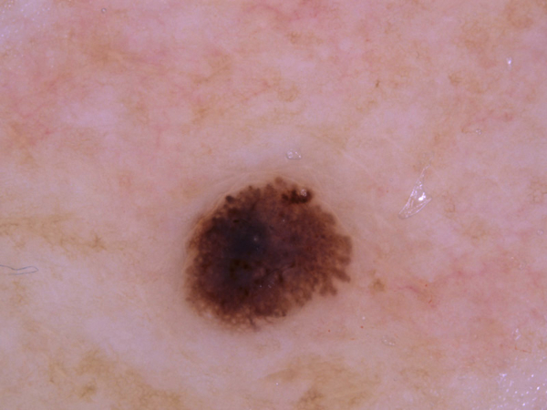
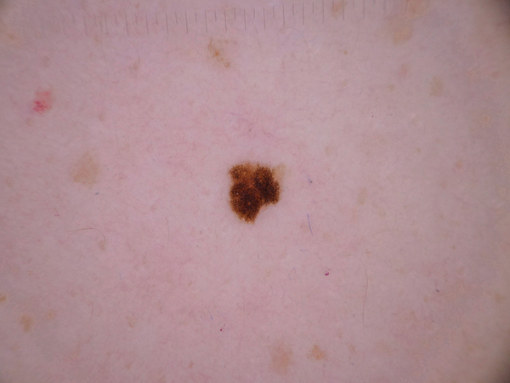
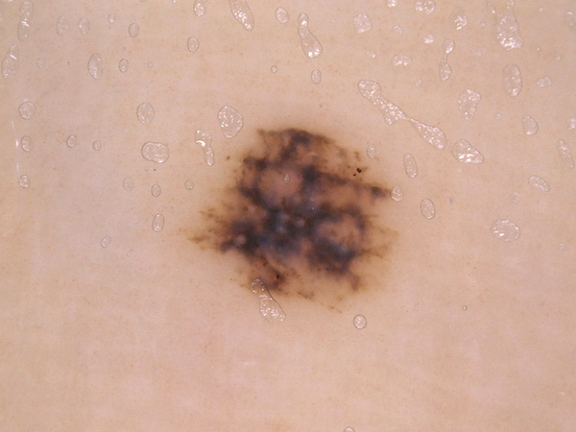
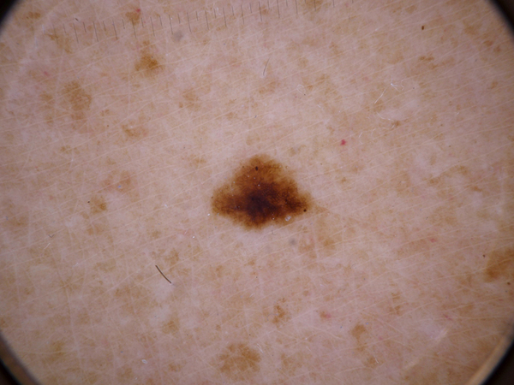

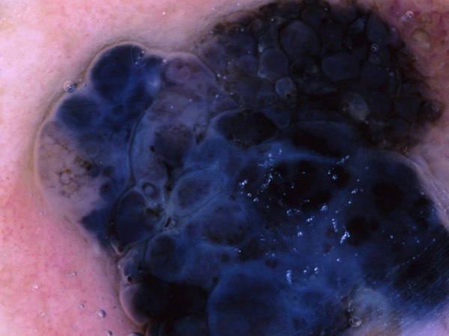
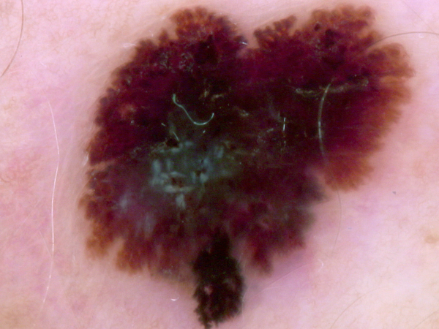
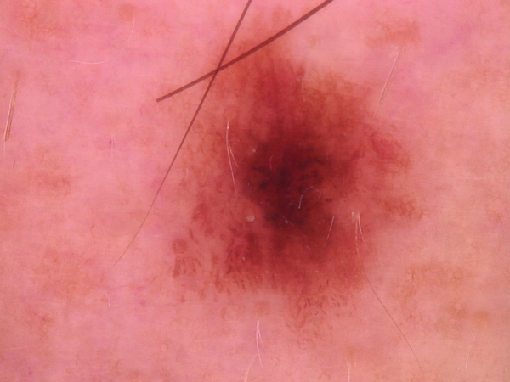
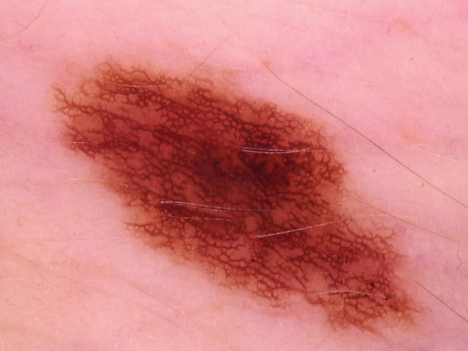
Predicted | Label
Melanoma | Nevus
Predicted | Label
Melanoma | Nevus
Predicted | Label
Nevus | Melanoma
Predicted | Label
Nevus | Melanoma
Predicted | Label
Melanoma | Melanoma
Predicted | Label
Melanoma | Melanoma
Predicted | Label
Nevus | Nevus
Predicted | Label
Nevus | Nevus

